Slide 1
Fall Seed Promotion
(farmer-facing email)
WinField United Local Campaign
ATLAS Materials

Slide 2
Topic: CROPLAN seed promo
SUBJECT LINE: Early-purchase incentives for CROPLAN seed
COPY: Seed purchased now means money in your pocket later.
Making seed decisions now has its advantages. The earlier you purchase, the greater your chances of locking in the seed size and hybrid trait or variety trait combination you want.
As a loyal CROPLAN® customer, we invite you to take advantage of our Early Seed Order Program and save some cash. There are two ways to participate:
• Order corn and/or soybeans by Month xx, 2020, and receive an early order discount.
• Increase your corn and/or soybean order from last year to receive an even larger incentive. See your [insert retail owner name] representative for details.
CROPLAN offers a comprehensive portfolio, with every seed backed by data and insights from rigorous testing through our Answer Plot® program. Read more about what you should consider when making seed selection decisions here.
Contact [insert retailer owner name] representative from more information or to lock in your order today.
LEGAL: Important: Before use always read and follow label instructions. Crop performance is dependent on several factors many of which are beyond the control of WinField United, including without limitation, soil type, pest pressures, agronomic practices, and weather conditions. Growers are encouraged to consider data from multiple locations, over multiple years, and be mindful of how such agronomic conditions could impact results.
© 2020 WinField United. Answer Plot®, CROPLAN® and WinField® are trademarks of WinField United.

Slide 3
Topic: General seed promo
SUBJECT LINE: Early-purchase incentives for your 2021 seed
COPY:
Avoid disappointment by locking in your seed preferences now.
The earlier you purchase your seed, the greater your chances of getting the seed size and hybrid trait or variety trait combination you want.
As a loyal [insert retail owner name] customer, we invite you to take advantage of our Early Seed Order Program to get the seed you want and save some cash. There are two ways to participate:
• Order corn and/or soybeans by Month xx, 2020, and receive an early order discount.
• Increase your corn and/or soybean order from last year to receive an even larger incentive. See your [insert retail owner name] representative for details.
We offer a comprehensive seed portfolio and can give you the performance data and agronomic insights you need to make the best seed decisions for your operation. Read more about what you should consider when selecting seed here.
We appreciate your business and look forward to continuing to work with you.
Contact [insert retailer owner name] representative from more information or to lock in your order today.
LEGAL: Important: Before use always read and follow label instructions. Crop performance is dependent on several factors many of which are beyond the control of WinField United, including without limitation, soil type, pest pressures, agronomic practices, and weather conditions. Growers are encouraged to consider data from multiple locations, over multiple years, and be mindful of how such agronomic conditions could impact results.
© 2020 WinField United. WinField® is a trademark of WinField United.

Slide 4

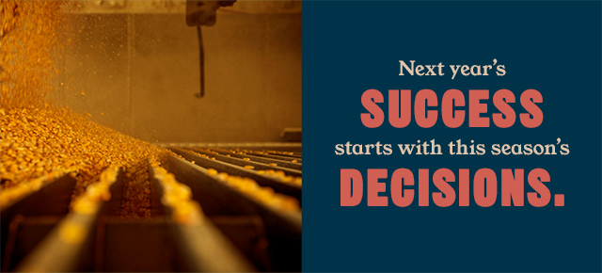
Email headers

